Slide 1
The Evolution of AI

Slide 2
The Evolution of AI

Slide 3
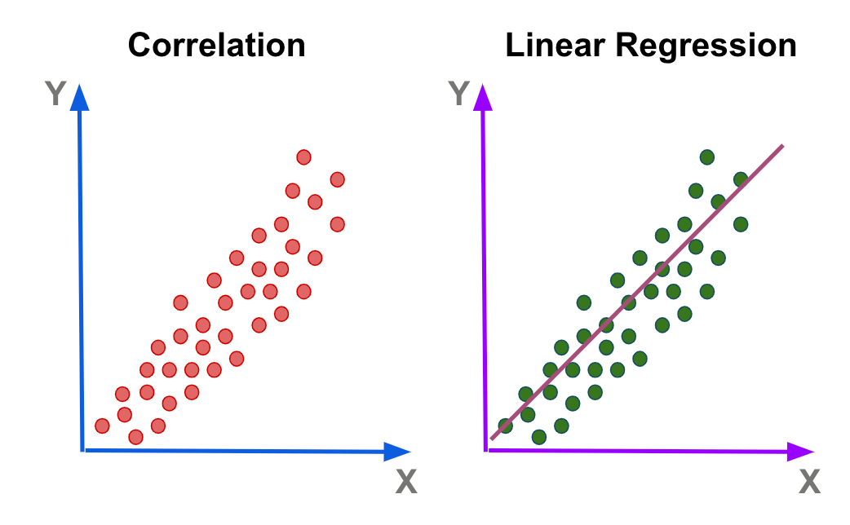
Linear Regression

Slide 4
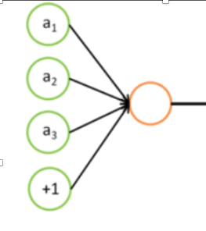

Slide 5
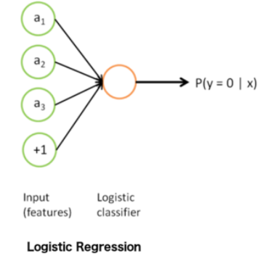
Logistic Regression

Slide 6
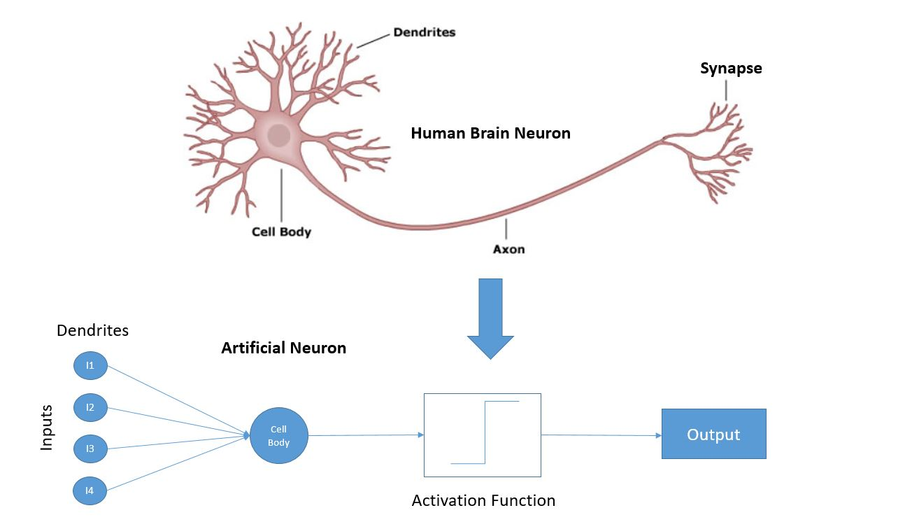
Neuron
Inputs
Weights
Bias
activation function
output = activation(Σ(weights × inputs)+ bias)

Slide 7
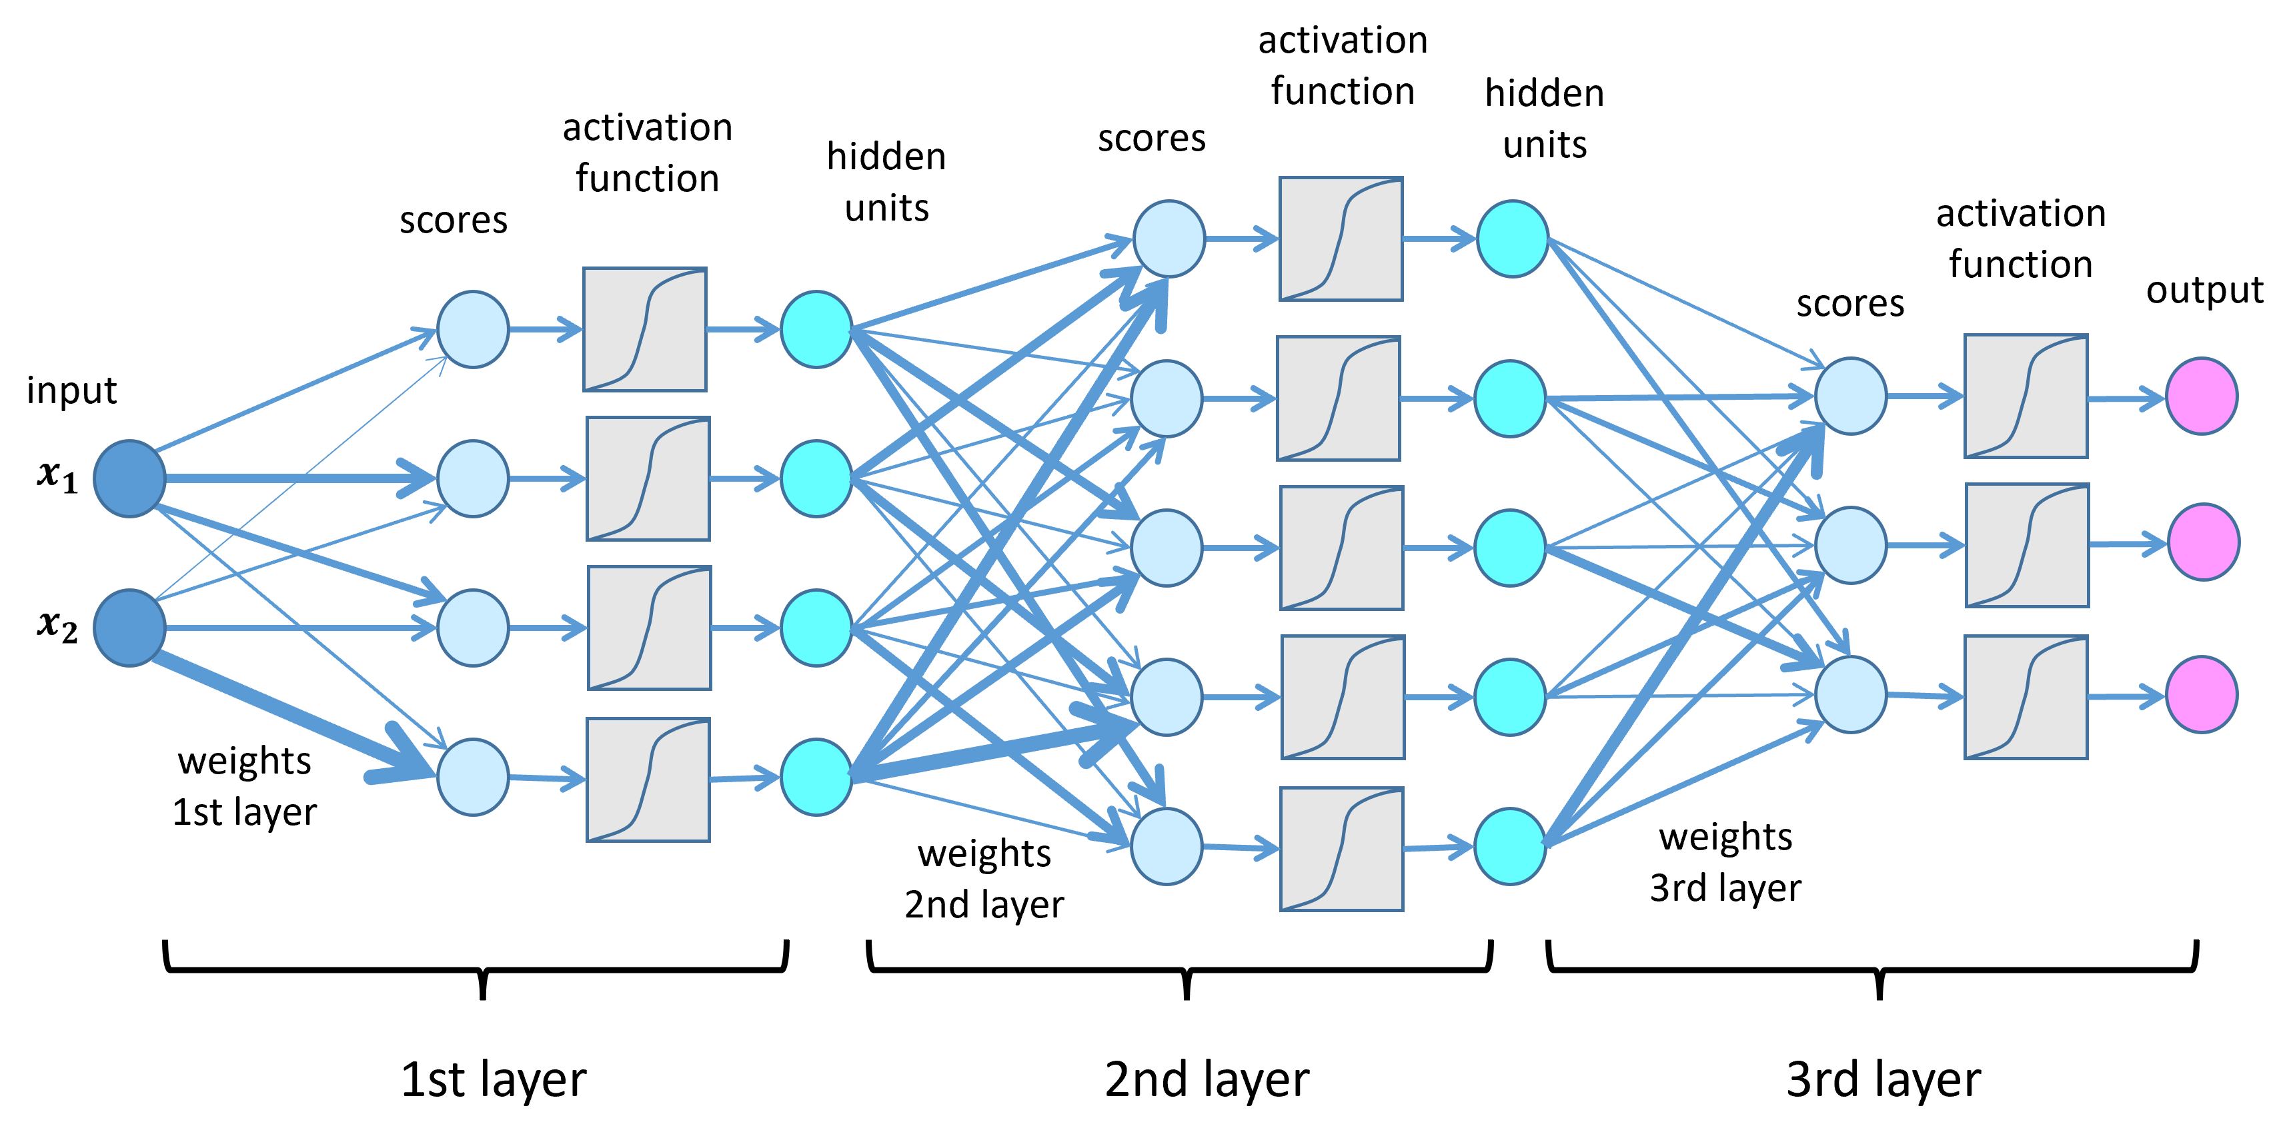
Basic Structure
Encoding
Input Layer
Hidden Layers
Output Layer
Decoding
Notes:
TODO: Code for basic deep learning, including encoding and decoding.

Slide 8
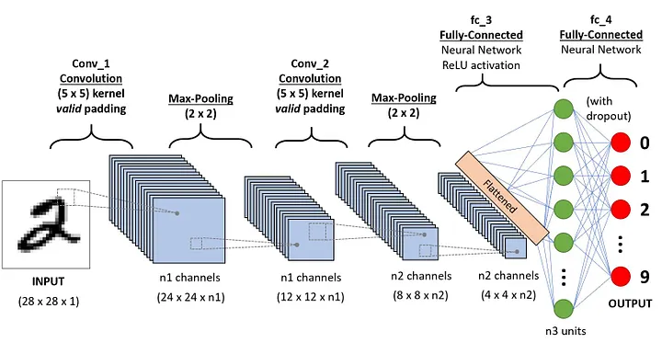
CNN (Convolutional Neural Network)

Slide 9
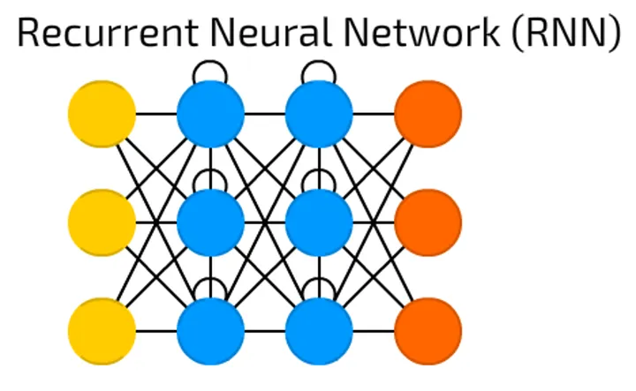
RNN (Recurrent Neural Network)

Slide 10
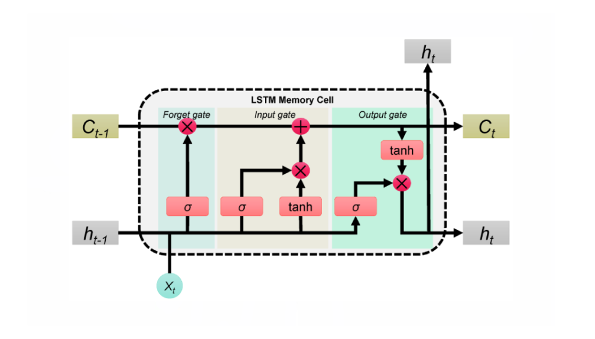
LSTM (Long Short-Term Memory)

Slide 11
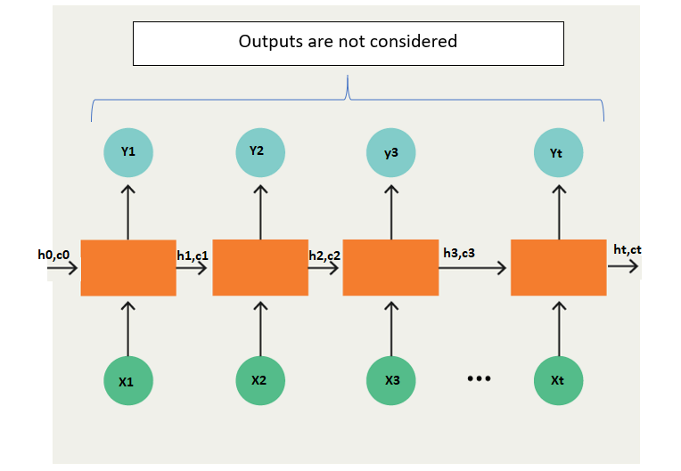
SEQ2SEQ (Sequence-to-Sequence)

Slide 12
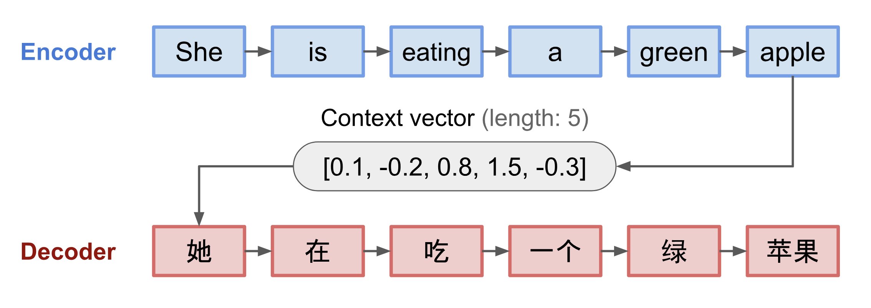
Example

Slide 13
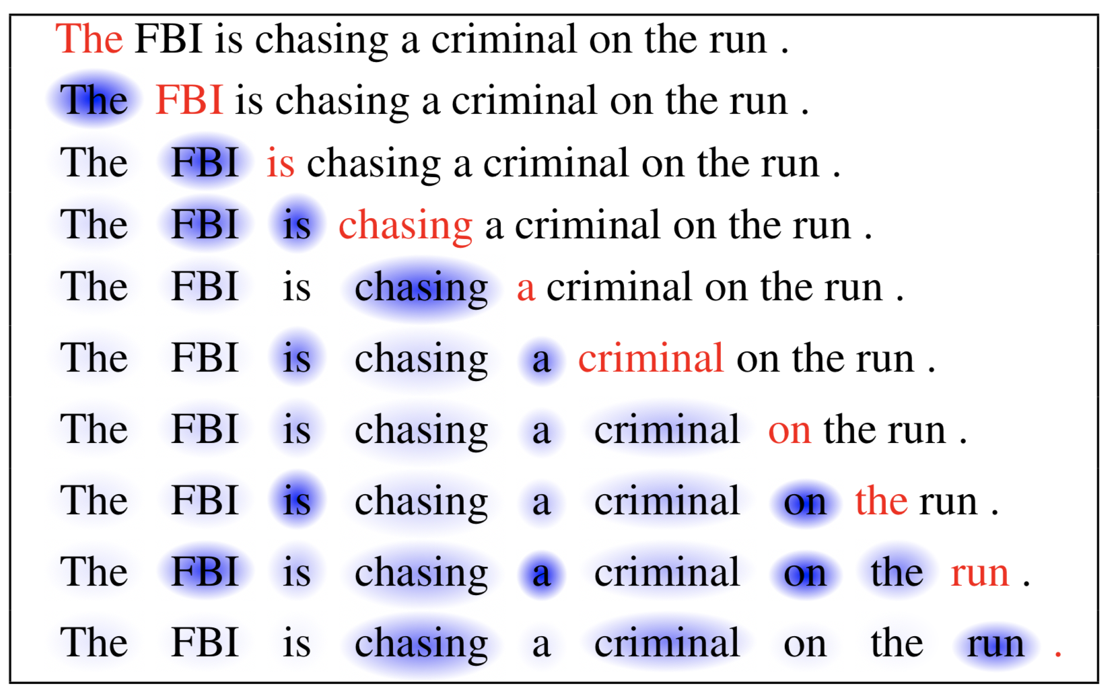
Self-Attention

Slide 14

Transformers
Works by paying attention to relationships between words
Powers models like GPT and BERT
With Encoder-Decoder
Notes:
http://jalammar.github.io/illustrated-transformer/

Slide 15
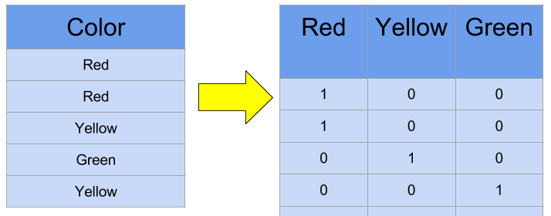
OnE HOT ENCODING

Slide 16
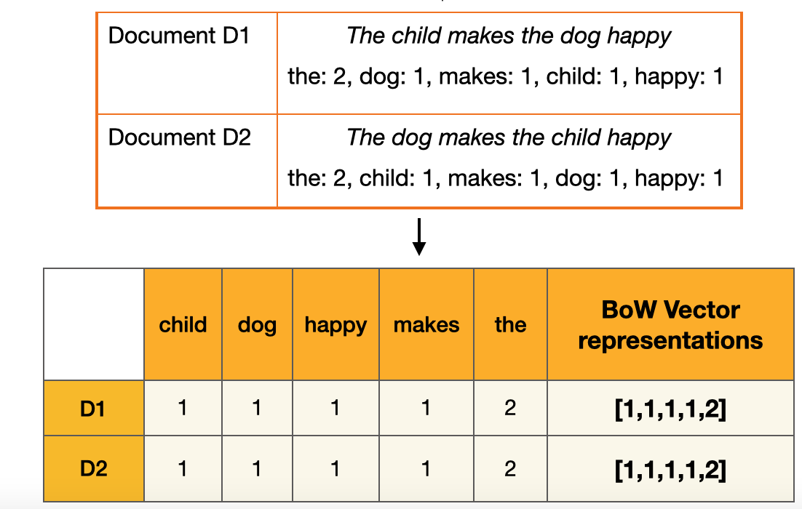
Bag-of-Words (BoW)

Slide 17
TF-IDF (Term Frequency-Inverse Document Frequency)
TF(w)=Number of times word w appears in a document​ / Total number of words in the document /
IDF(w)=log(Total number of documents​ / Number of documents containing w)
TF-IDF = TF * IDF

Slide 18
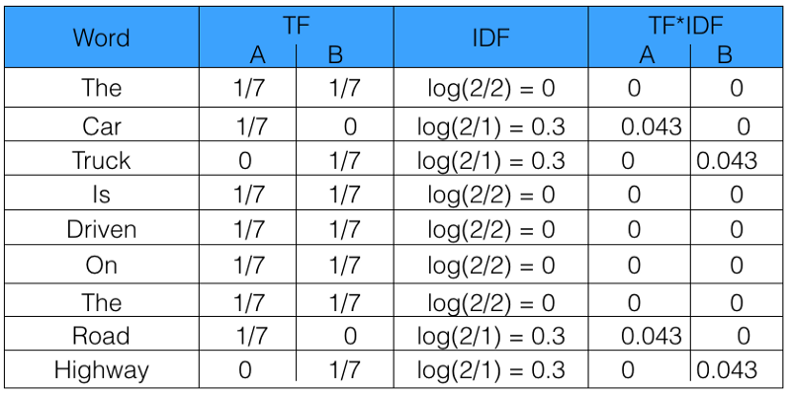
TF-IDF

Slide 19
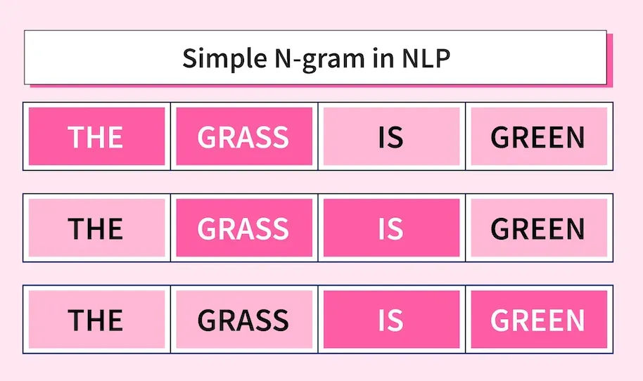
N-gam

Slide 20
Word2Vec
Unsupervised Learning
CBOW (Continuous Bag of Words): Predicts the target word based on its surrounding context words.
Skip-gram: Predicts the surrounding context words given a target word.
Words with similar meanings have closer vectors.
Semantic relationships (e.g., synonyms) and syntactic patterns (e.g., verb tenses) are preserved.

Slide 21
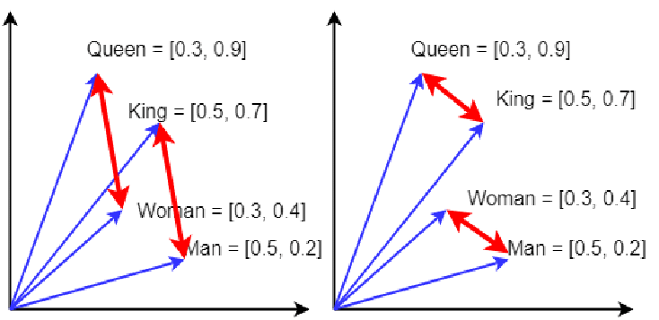
Embeddings capture meaning
Close embeddings indicate two things have similar meanings
The difference between embeddings indicate how different they are
The length of an embedding indicates the certainty

Slide 22
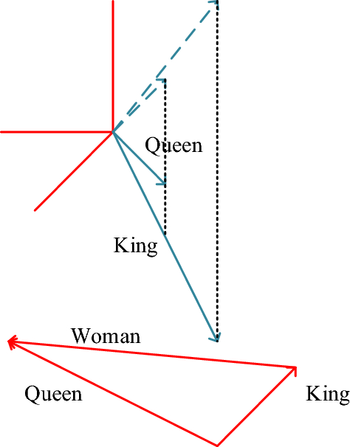
Compare angles with cosine
Cosine converts the angle difference into a number the model can use.

Slide 23
Transformers
Works by paying attention to relationships between words
Powers models like GPT and BERT
With Encoder-Decoder
Notes:
http://jalammar.github.io/illustrated-transformer/

Slide 24
LLM
Tasks
Tasks
…
…
Text generation
Text generation
…
…
Summarization
Summarization
Unlabeled text data
LLM
Labeled data
ML models
Information extraction
Information extraction
…
…
Q&A
Q&A
…
…
Chatbot
Chatbot
Train
Deploy
Pretrain
Adapt
Traditional ML models
Foundation models

Slide 25
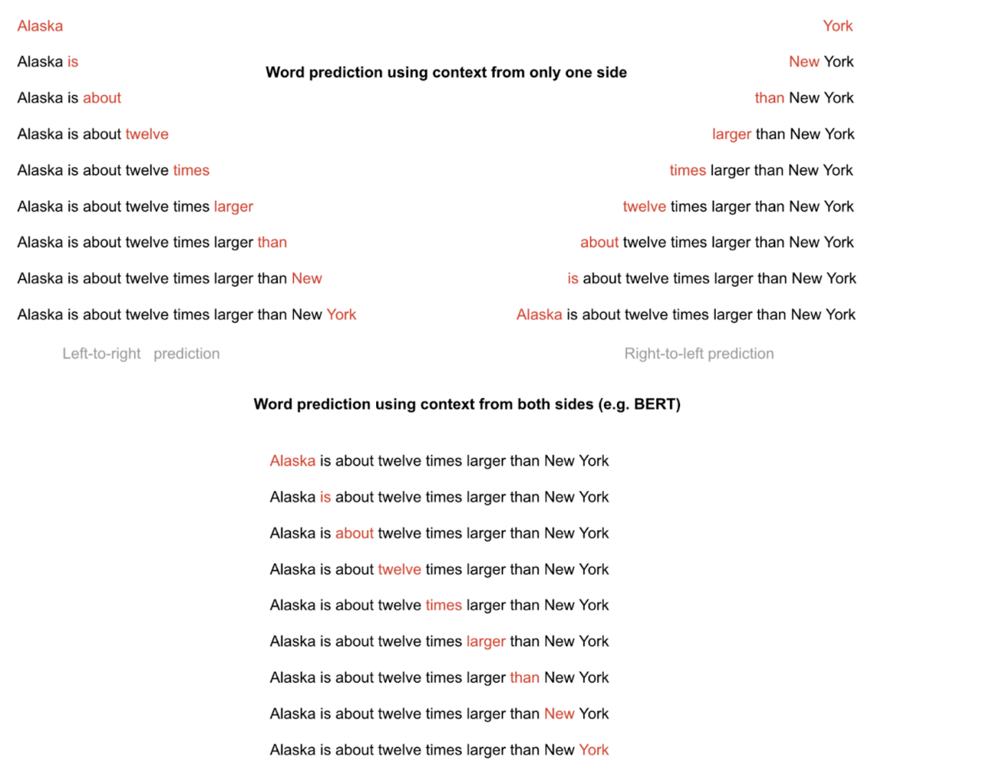
Word Masking

Slide 26
BERT Family
Bidirectional Encoder Representations from Transformers
Bidirectional attention
Masked language modeling
Good for understanding

Slide 27
GPT Family (Generative Pre-trained Transformer)
GPT series, LLaMA, PaLM
Autoregressive
Left-to-right generation
Good for generation

Slide 28








Diffusion Models
Forward process gradually adds noise to the image
Reverse process removes noise from the image
Forward process (create noisy samples)
Reverse process (generate image from noise)

Slide 29
Denoising process
A neural network predicts the noise and this predicted noise is subtracted from the noisy image from the previous timestep.
Neural Network
-
Noisy image at timestep t
Predicted noise
Less noisy image at timestep t-1
Timestep t

Slide 30
GAN (Generative Adversarial Network)
StyleGAN, CycleGAN
Generator-Discriminator
Adversarial training
Good for realistic generation

Slide 31
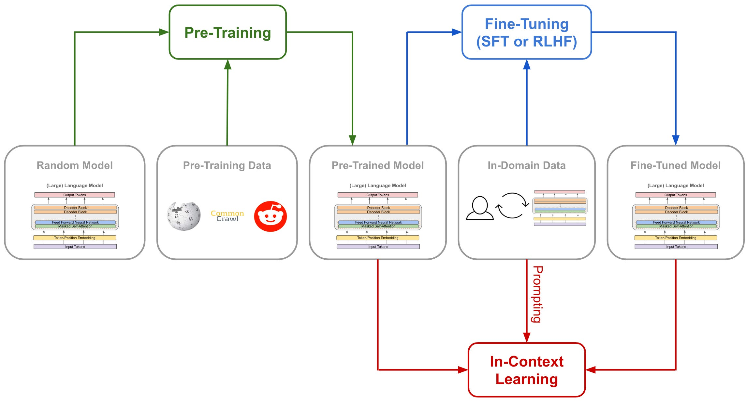
Training

Slide 32
Training – Dataset Preparation
Data Collection:
Curate diverse and representative datasets (e.g., Common Crawl, books, Wikipedia).
Handle domain-specific data when training for specialized tasks (e.g., medical, legal).
Preprocessing
Text tokenization (subwords, SentencePiece, Byte-Pair Encoding).
Normalization: Lowercasing, removing duplicates, handling Unicode characters.
Filtering: Removing noisy data (e.g., irrelevant, incomplete, or offensive text).
Data Augmentation
Masked token prediction (for models like BERT).
Synonym replacement, paraphrasing, or noise injection for training robustness.

Slide 33
Training Objectives
Causal Language Modeling (CLM): Predict the next token based on previous tokens (e.g., GPT).
Masked Language Modeling (MLM): Predict masked tokens in a sequence (e.g., BERT).
Seq2Seq Learning: For translation or summarization tasks (e.g., T5).

Slide 34
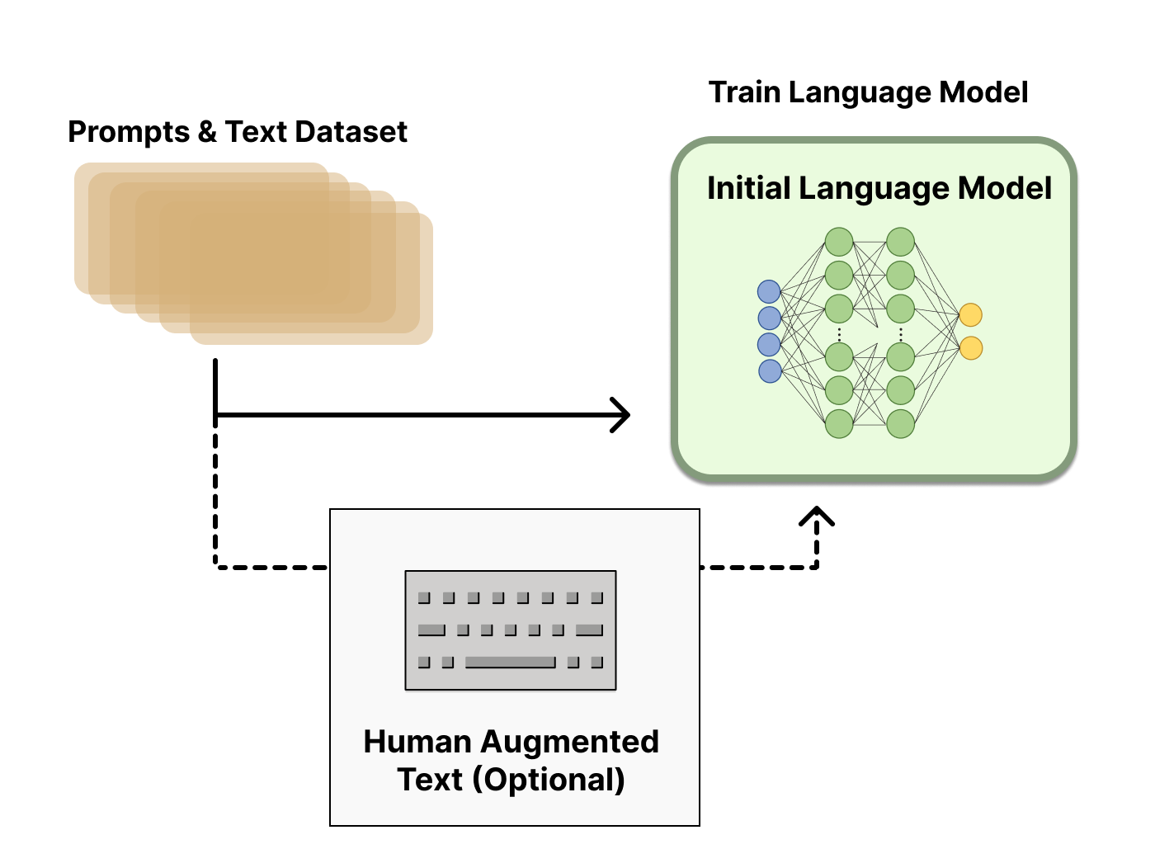
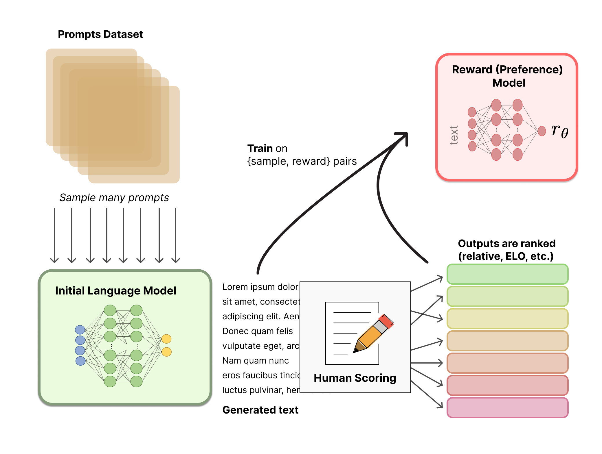
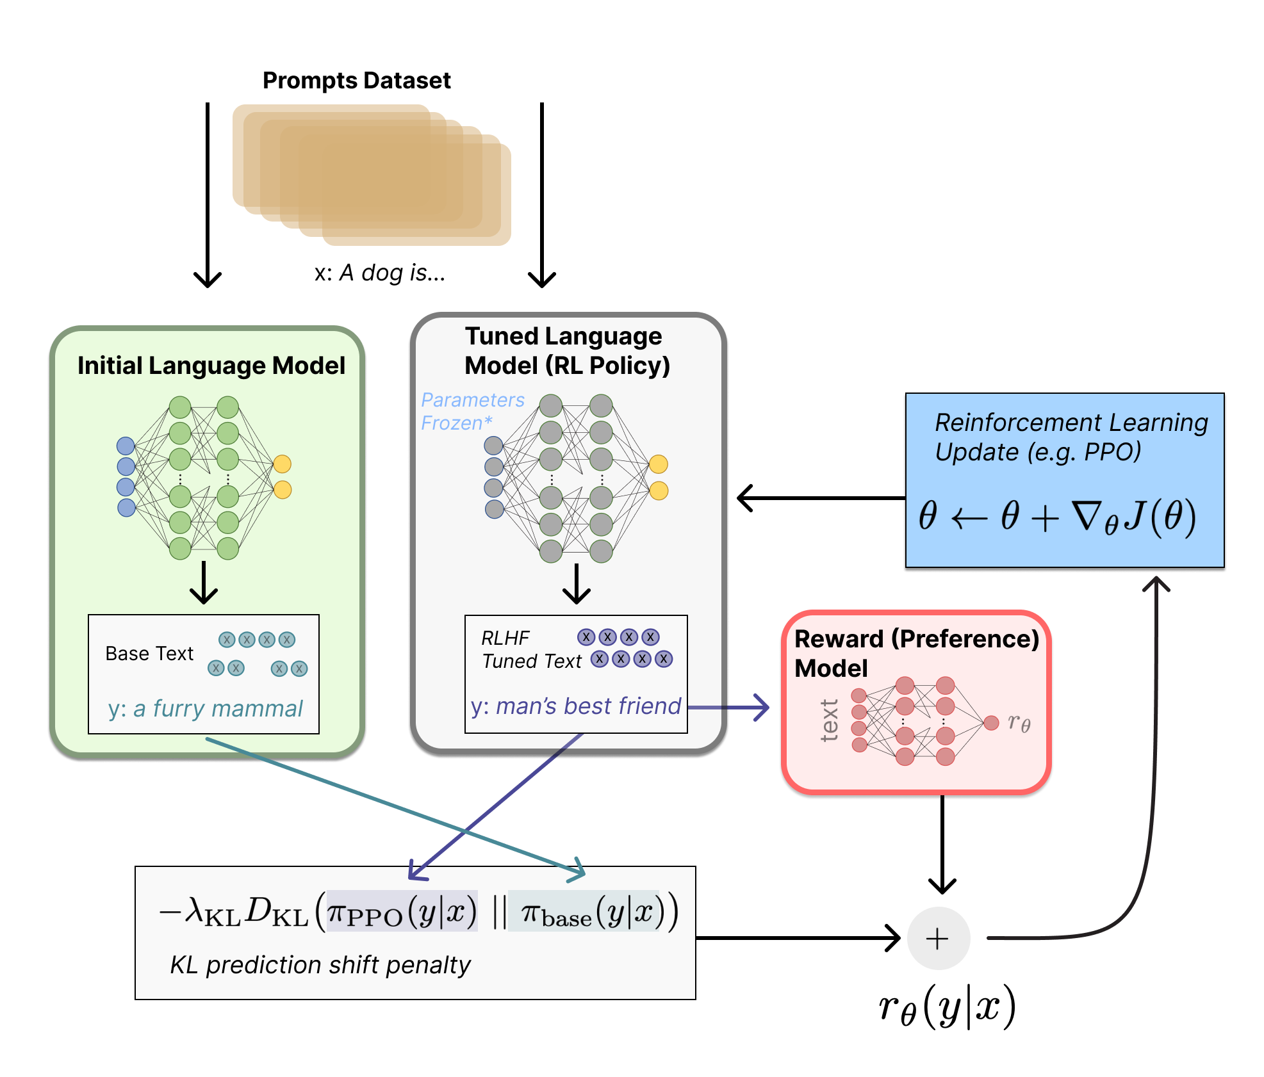
Reinforcement Learning through Human Feedback (RLHF)
Enables LLMs to begin to align a model trained on a general corpus of text data to that of complex human values.
Common sense reasoning
Truthfulness
Three core steps:
Fine-tuning the LLM
Training reward model using human feedback
Fine-tuning LLM using Reinforcement Learning

Slide 35
Evaluating LLMs using Metrics
Perplexity
Measure how much the model is ‘surprised’ by seeing new data
Cross-Entropy
Used to compare two probability distributions
For LLMs, compare predicted probability distribution over the words with actual distribution
Human Evaluation
Truly evaluate real-world performance
Rate readability, syntax, cohesiveness etc.

Slide 36
GLUE Benchmark
General Language Understanding Evaluation (GLUE) Benchmark
Model-agnostic
SuperGLUE: Updated benchmark with more difficult NLU tasks
Type of Tasks | Evaluation Tasks
Single Sentence Tasks | The Corpus of Linguistic Acceptability (CoLA)
 | The Stanford Sentiment Treebank (SST-2)
Similarity and Paraphrase Tasks | The Microsoft Research Paraphrase Corpus (MRPC)
 | The Quora Question Pairs (QQP)
 | Semantic Textual Similarity Benchmark (STS-B)
Inference Tasks | Multi-Genre Natural Language Inference (MNLI)
 | The Stanford Question Answering Dataset (QNLI)
 | The Recognizing Textual Entailment (RTE)
 | The Winograd Schema Challenge (WNLI)

Slide 37
Metrics - BERTScore
Definition: Computes semantic similarity by comparing embeddings (e.g., BERT) of generated and reference text.
Use Case: Creative tasks like summarization, paraphrasing, or storytelling.
Strengths: Captures meaning, context, and paraphrasing.

Slide 38
Metrics - Sentence Mover's Similarity (SMS)
Definition: Measures how semantically similar the generated text is to the reference by aligning sentence embeddings.
Use Case: Long-form generation tasks.

Slide 39
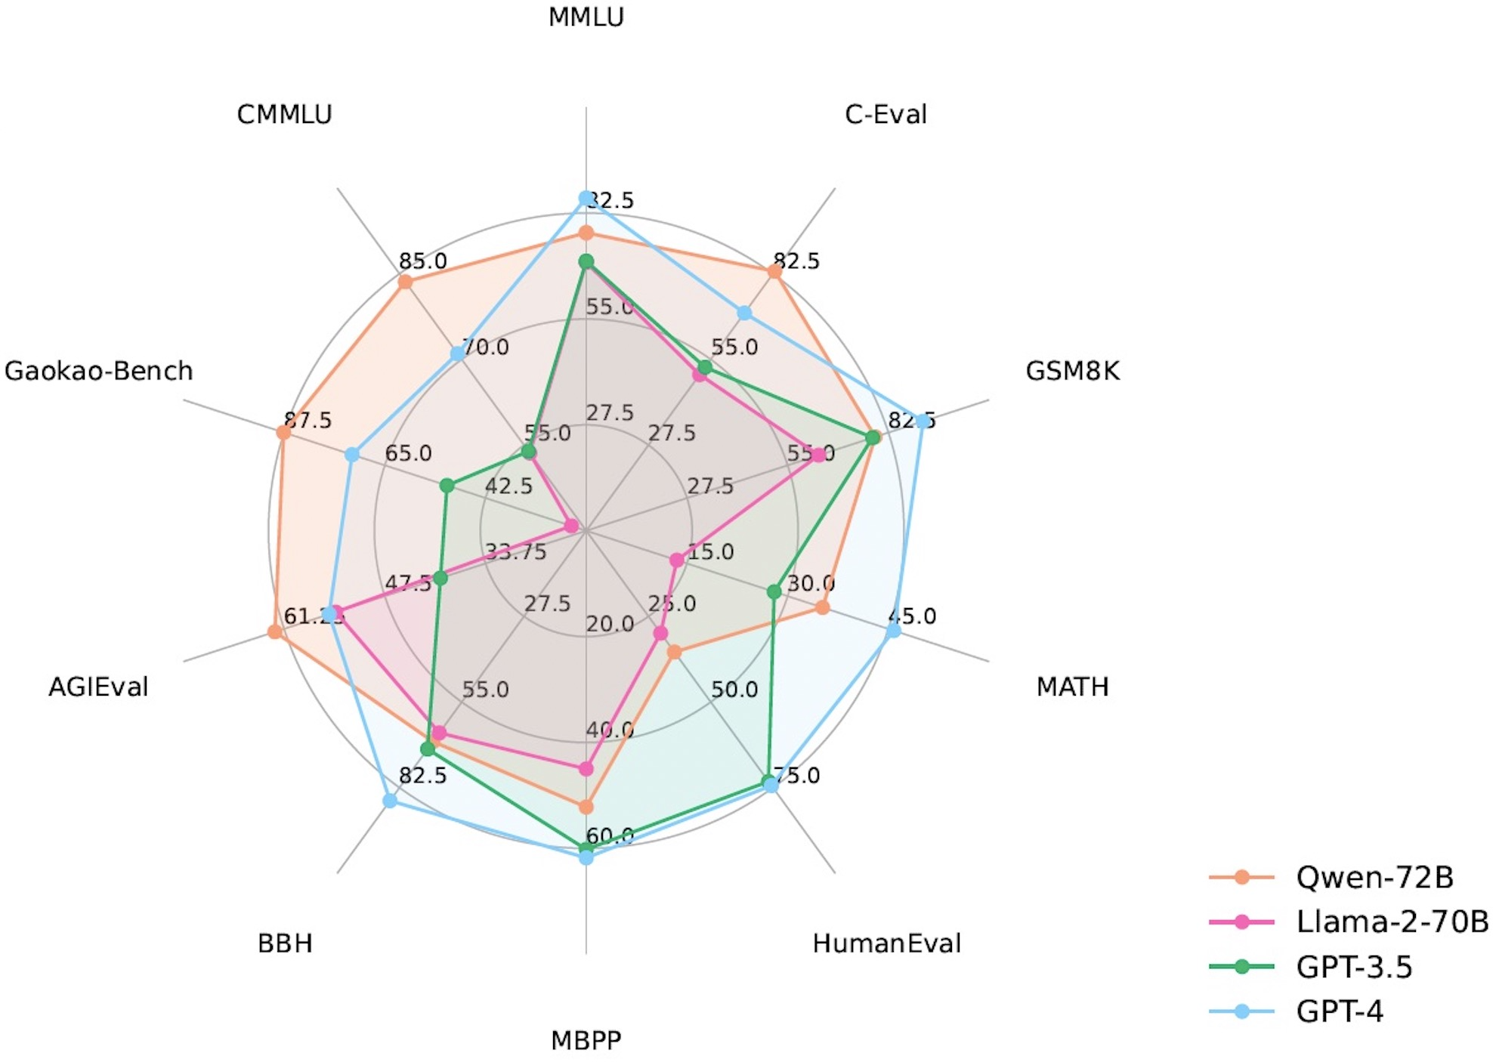

Slide 40
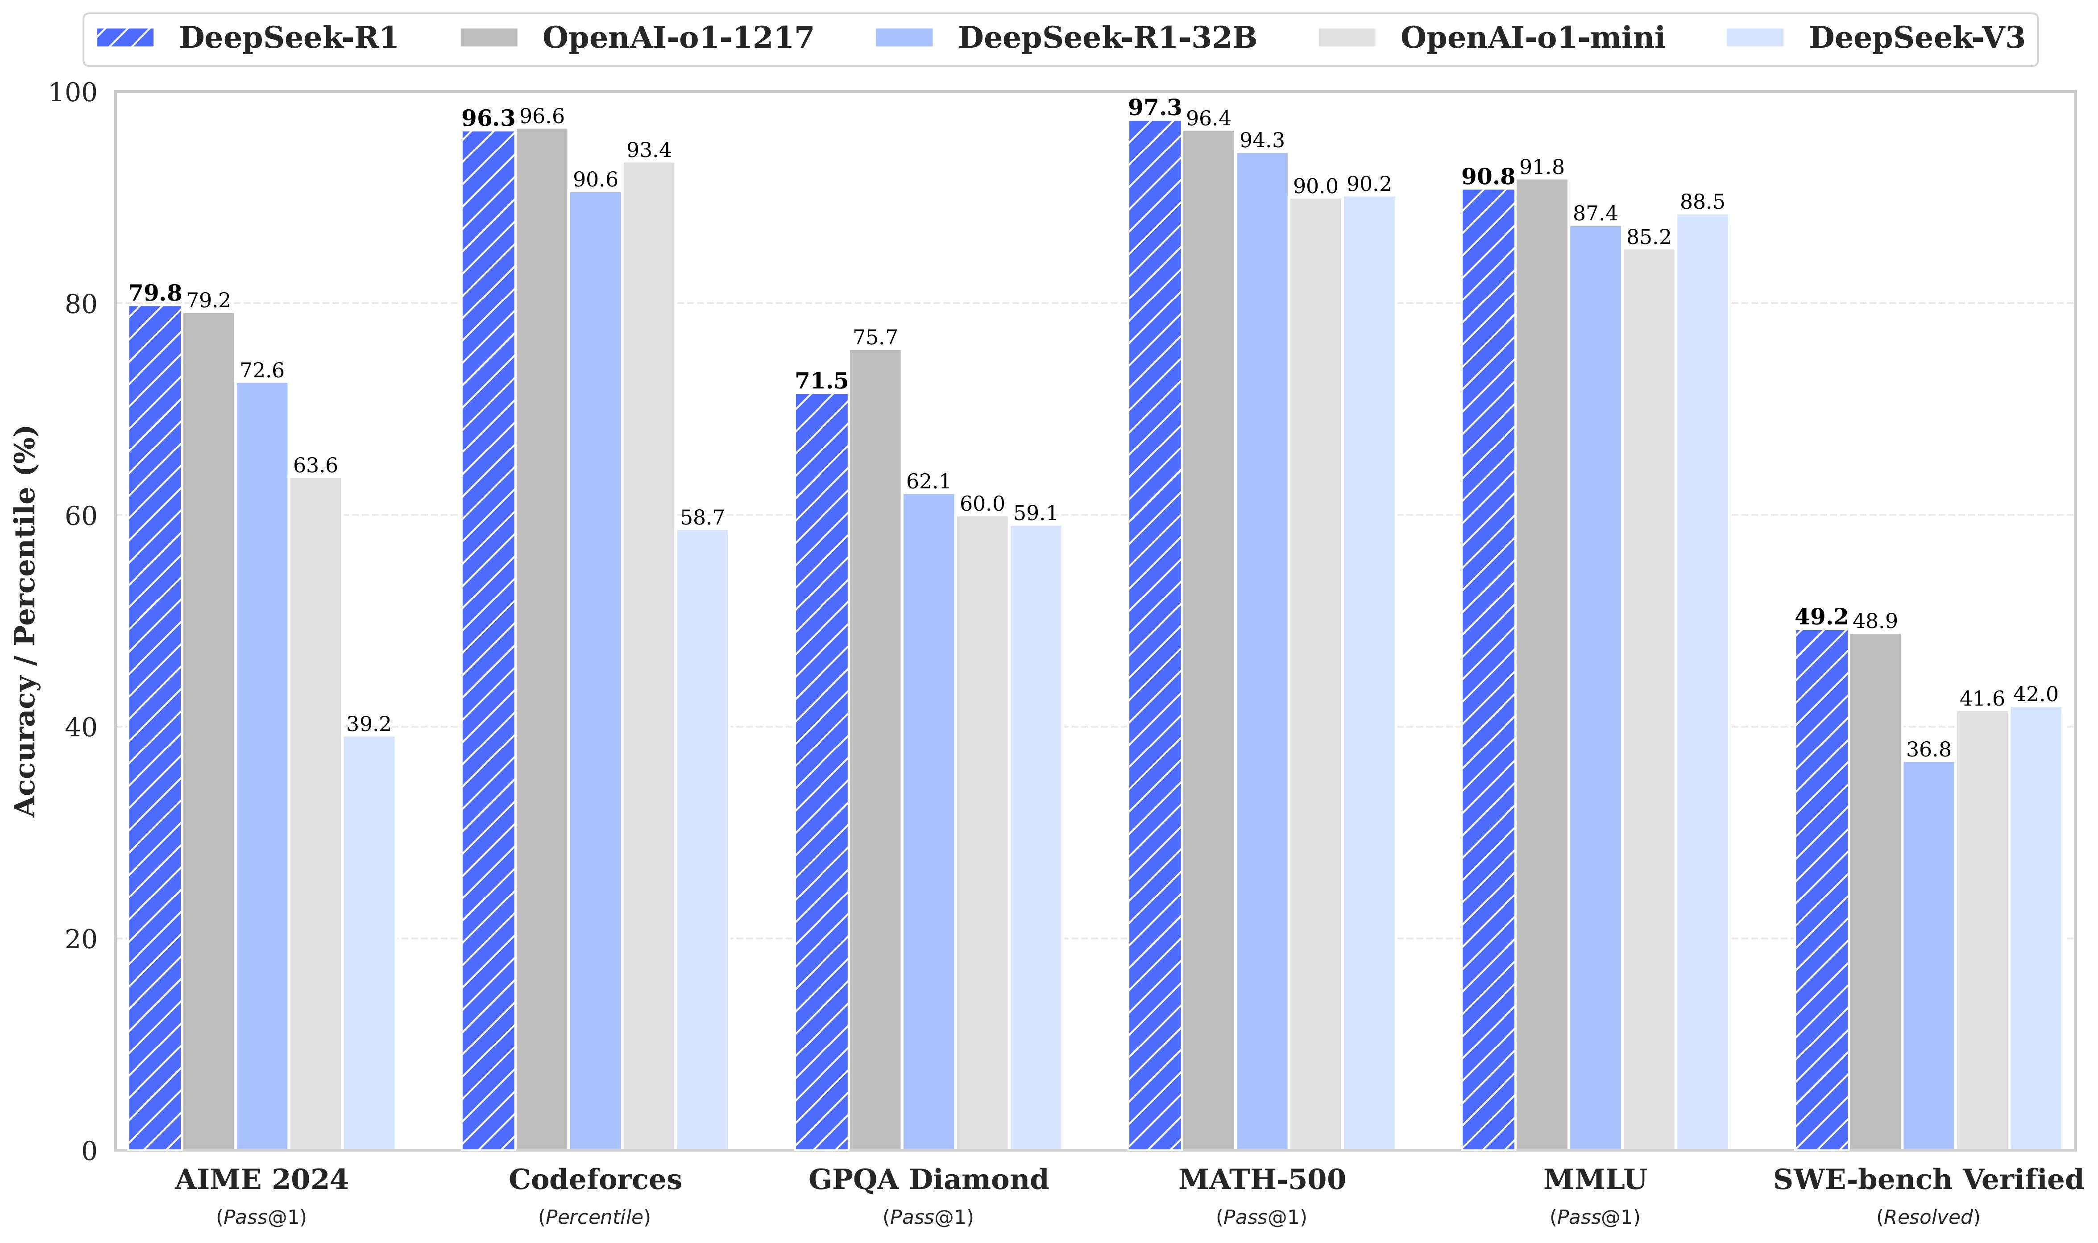

Slide 41
In-context vs. training
 | Training | In-Context ‘learning’
Goal | Learn language / concepts | Respond to prompts
Input | Curated and clean training data | Prompts from users
Output | New version of the model | Responses
Is the model changed? | Yes | No
Lifecycle | Pre-Training, Fine-Tuning | Production

Slide 42
Stages of Large Models
The model is processing documents
The model is being refined and changed.
Pre-training
Fine-tuning
Production (inference)

Slide 43
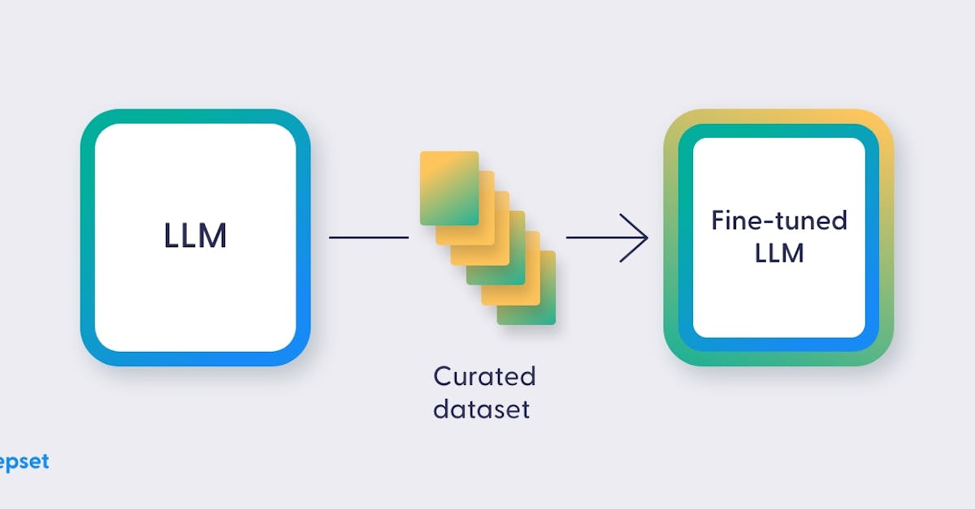
fine-tune an LLM

Slide 44



System prompts
Application adds a prologue to the prompt before the model sees it:
You are a helpful, respectful and honest assistant. Always answer as helpfully as possible…
Where is the best place…
Where is the best place…
Prompt
Edited Prompt
Response
Response
Application
Generative AI
The Columbia Center…

Slide 45
Parameters for content generation
Inference parameters help control and customize the model’s response.
Here are some important inference parameters:
Temperature: controls the randomness. Use T=0 to make the output deterministic. Use higher temperatures to generate more unexpected text.
Top p: selects next word from those with probabilities summing up to said value.
Top k: picks up next token from the top “k”, sorted by probability.
Maximum number of tokens: controls the length of the generated response.
Stop sequences: stops generating text when it encounters these sequences.

Slide 46
Good prompting practices
Here are a few suggestions to help you construct better prompts:
Write clear and specific instructions (unambiguous and specific).
Highlight or specify the part of the prompt that the model should focus on.
Add details or restrictions to your prompt.
Finding the optimum prompt is usually an iterative process which may take a few attempts.
If the problem requires executing multiple steps, instruct the model to follow a step-by-step approach.

Slide 47
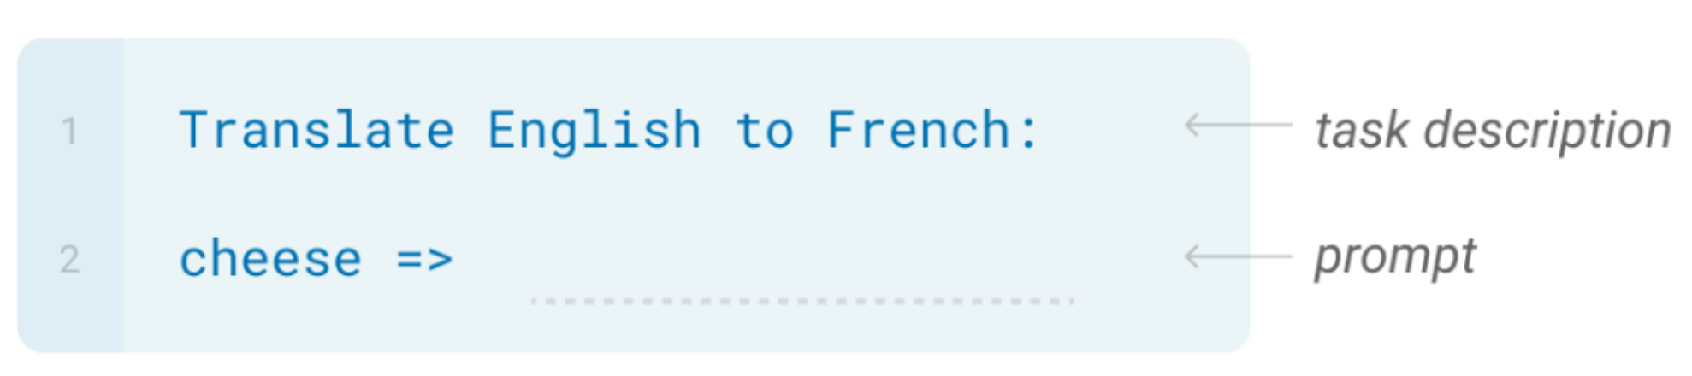
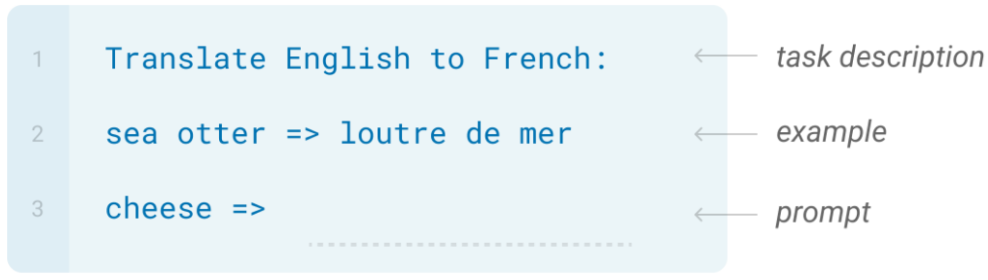
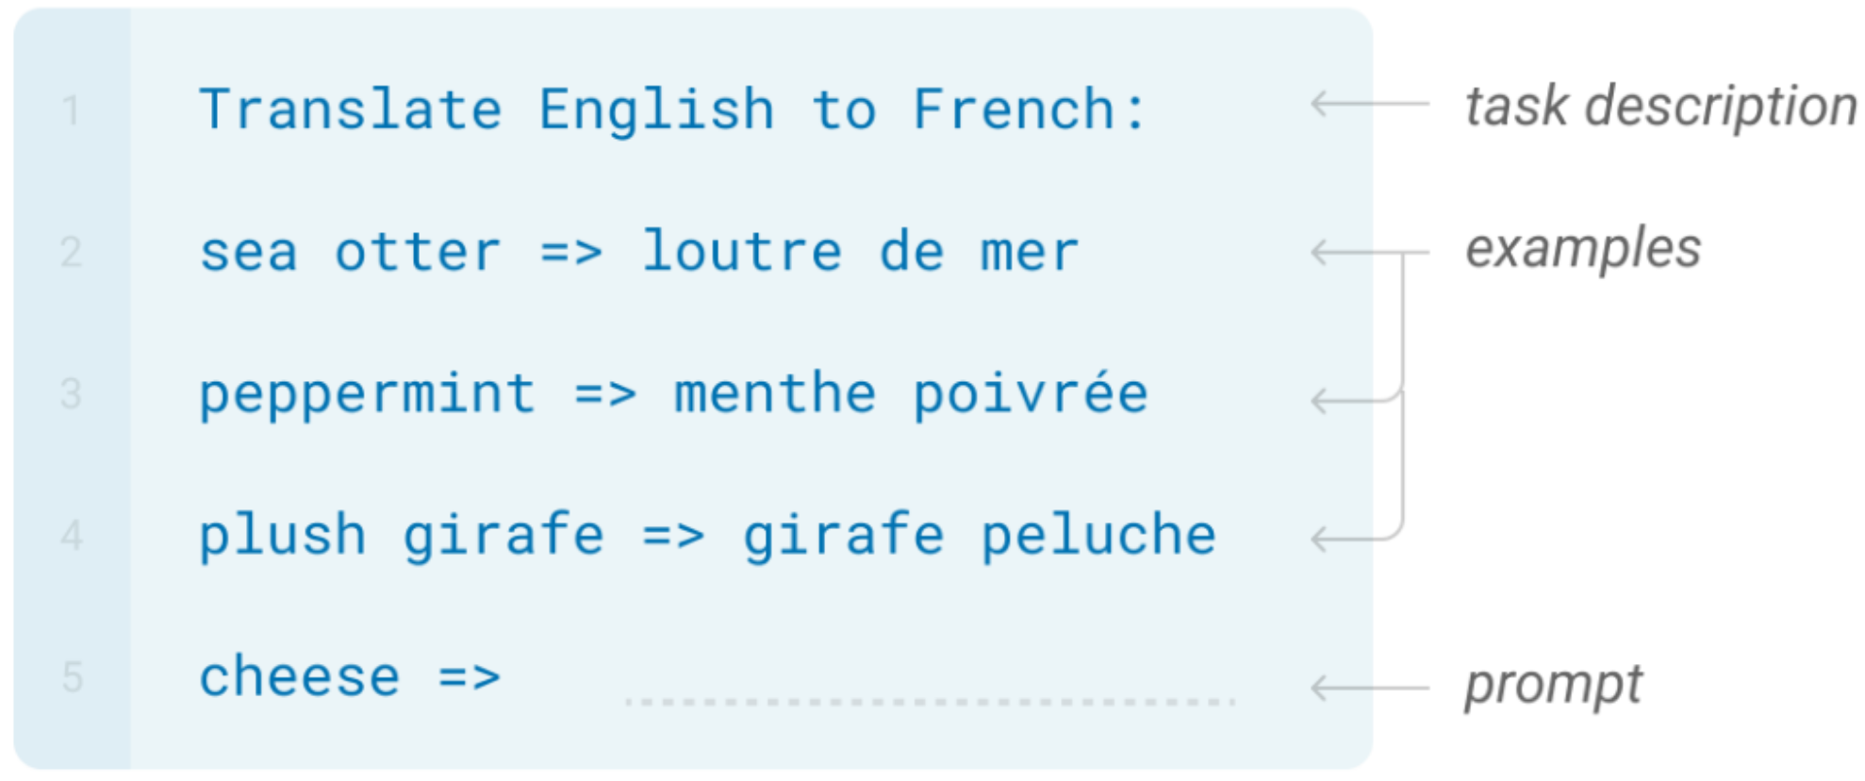
In Context Learning
Zero-shot Learning
One-shot Learning
Few-shot Learning

Slide 48
Chain-of-thought prompting
CoT
Input
Technique that breaks down complex tasks through intermediate reasoning steps.
Encourages model to explain its reasoning process by decomposing the solution into a series of steps.
This behaviour can be facilitated through various strategies (few-shot CoT, zero-shot CoT, …).
CoT is the basis for other prompting techniques which separate out the task’s decomposition and its solving.
……
Output

Slide 49
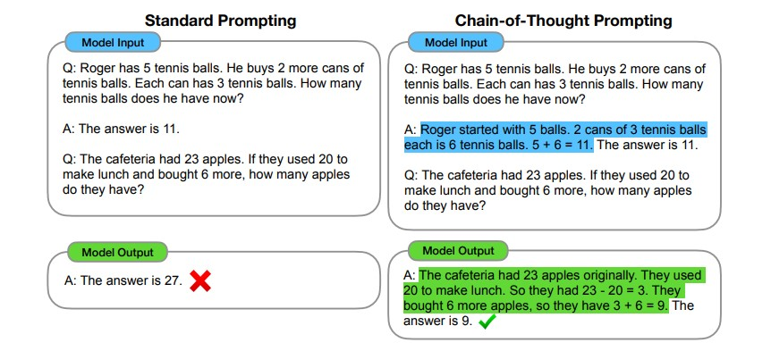
CoT Example

Slide 50
Benefits and limitations of CoT
LLMs can benefit from detailed and logical steps to process the prompt.
Such chains of thought can be facilitated by:
Addition of smaller logical steps in the prompt to break down the question or task.
A series of demonstrations, composed of question and reasoning chain leading to an answer.
Prompt augmentations like “Let’s think step by step”.
CoT can enhance performance of LLMs on tasks requiring arithmetic, common-sense, and symbolic reasoning.
CoT prompts (especially few-shot examples) are specific to a problem type.
Performance gains in models of ~100B parameters [Wei et al. 2022].
Smaller models might produce fluent but illogical CoT, with lower performance.

Slide 51
Overview of basic techniques and use cases
Method | Use case
Zero-shot prompting | Tasks that the LLM is capable of performing simply leveraging the information from the large amounts of data it has been pre-trained on.
One-shot prompting | Output needs to follow a certain structure that can be demonstrated via one example.
Few-shot prompting | Output needs to follow a certain structure that can be demonstrated via various examples.
Chain of thought | Complex tasks that require reasoning before a response can be generated.

Slide 52
Advanced prompting
Input-Output
CoT
Self-consistency
ToT
Input
Input
Input
Input
……
……
……
……
Majority vote
Output
Output
Output
Output

Slide 53
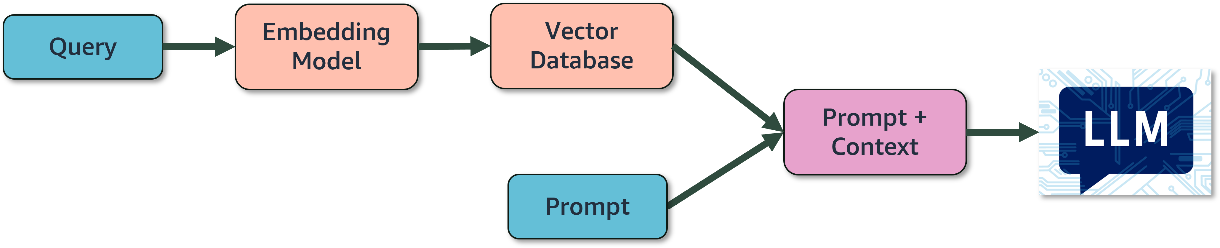
Retrieval Augmented Generation (RAG)
Query may come from an user or another LLM
Convert query to embedding
Find similar chunks in the vector database
Augment prompt with retrieved results

Slide 54
Agent
Large Language Model
Application Code
Episodic
Memory
Semantic
Memory
Decision Procedure
Working Memory

